Slide 1


VIRTUAL DESKTOP ASSISTANT
Mini project

Slide 2

INTRODUCTION
Good day everyone, today I will be presenting on Virtual Desktop Assistant
A Virtual Desktop Assistant is a software application
that can perform tasks and answer questions for users on a virtual desktop environment
This type of technology uses artificial intelligence
natural language processing and machine learning
to understand and respond to user requests.

Slide 3
ABSTRACT
In the era of digital transformation, the integration of virtual assistants has revolutionized the way humans interact with computers and perform tasks.
The Virtual Desktop Assistant mini project aims to develop a responsive and intuitive virtual assistant system designed to enhance user productivity and streamline daily computing tasks.
The project leverages natural language processing and machine learning techniques to create a personalized and context-aware assistant that can efficiently execute commands, retrieve information, and perform various tasks based on user input.
The system will be implemented as a standalone application that runs on a user's desktop, allowing seamless interaction with the underlying operating system and applications.

Slide 4
Key features of the VDA include
Speech Recognition : The assistant is equipped with advanced speech recognition enabling users to interact with the system using voice commands and natural language queries.
Task Automation: The assistant can automate a range of tasks such as file management, application launching, email composition, and web searches, reducing manual intervention and increasing efficiency.
User-Friendly Interface: The system provides a user-friendly graphical interface where users can input text or speak commands. The assistant's responses are displayed on the interface, enhancing communication and user engagement.
Extensibility: The mini project is designed with extensibility in mind, allowing developers to easily add new features, expand the assistant's capabilities, and integrate it with third-party applications.

Slide 5
OBJECTIVES
Design and develop a functional virtual desktop assistant system that operates seamlessly on a user's desktop environment.
Implement robust speech recognition capabilities to allow users to interact with the assistant using voice commands, enhancing accessibility and user experience
Design an intuitive and user-friendly graphical interface that allows users to input text or voice commands and receive responses from the assistant in a clear and organized manner
Create comprehensive documentation and user guides that detail the functionalities, capabilities, and usage instructions of the virtual desktop assistant, making it easy for users to interact effectively with the system.

Slide 6
REQUIREMENT SPECIFICATION
We used the language python for building this project :
Python is a general purpose ,interpreted ,interactive and object oriented programming language.
The system requirements were :
We used the VS code IDE for building this project.
An 64-bit operating system.
RAM of 4GB and some useful packages of python such as SpeechRecognition , Wikipedia and Other useful packages.
Microphone of the laptop.

Slide 7
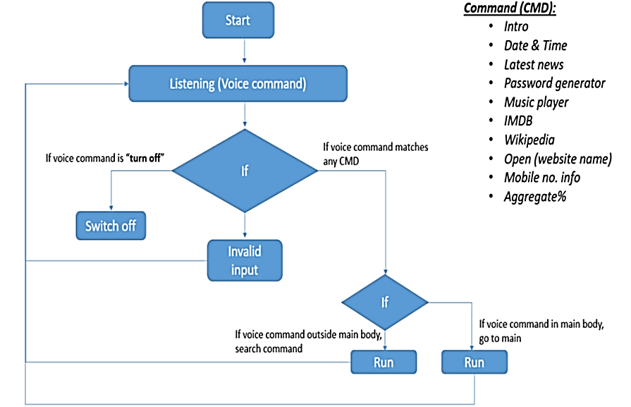
FLOW CHART

Slide 8
APPLICABILITY
Voice Commands : Virtual assistants that support voice commands allow for hands-free interaction, making it convenient to perform tasks while multitasking or when your hands are occupied.
Entertainment : You can use a virtual assistant to play music, recommend movies, and suggest other forms of entertainment based on your preferences.
Mental Health Support : Some virtual assistants are designed to offer emotional support, provide relaxation techniques, and suggest mindfulness exercises.

Slide 9
What Our Project Can Do
Open YouTube
Play any Music
Initiate Google’s Search
Calculate Anything
Know the Date and Time
Listen to Jokes for Fun
Send mail with our college mail
Search Anything or Anyone on Wikipedia
Writing some Notes
Shutdown the Desktop
Restart the Desktop etc.

Slide 10
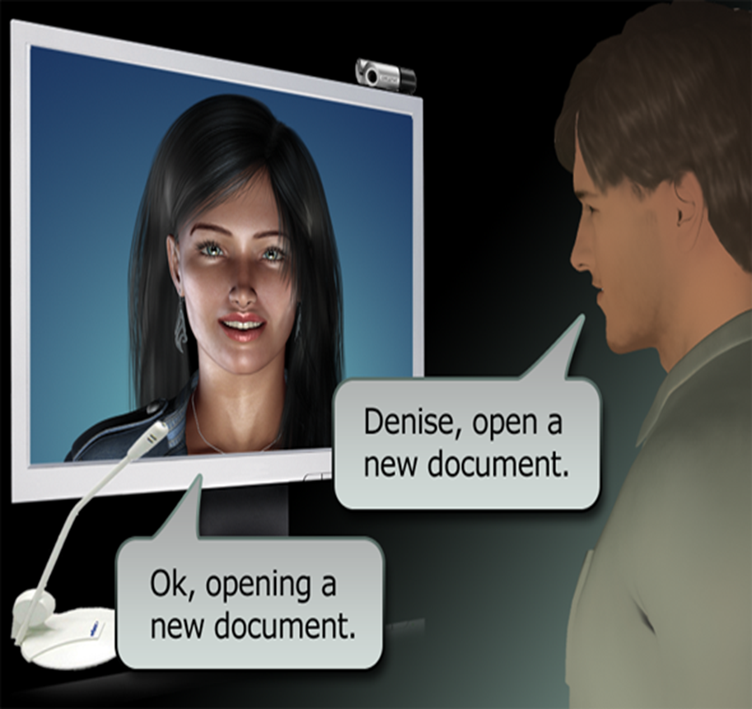
IMAGE

Slide 11
Limitations:
Dependency on Internet Connectivity: Many virtual assistants rely on internet connectivity for processing and retrieving information. Without a stable internet connection, their functionality can be severely limited.
Privacy Concerns : Virtual assistants require access to personal data and interactions, raising concerns about data privacy and security. Users must be cautious about sharing sensitive information.
Limited Multitasking Abilities: While virtual assistants can perform multiple tasks, they might struggle with complex multitasking scenarios or handling multiple tasks simultaneously.
Though it simplifies many of the user tasks but sometimes it provides fault or incorrect results.
It also increases response time.

Slide 12
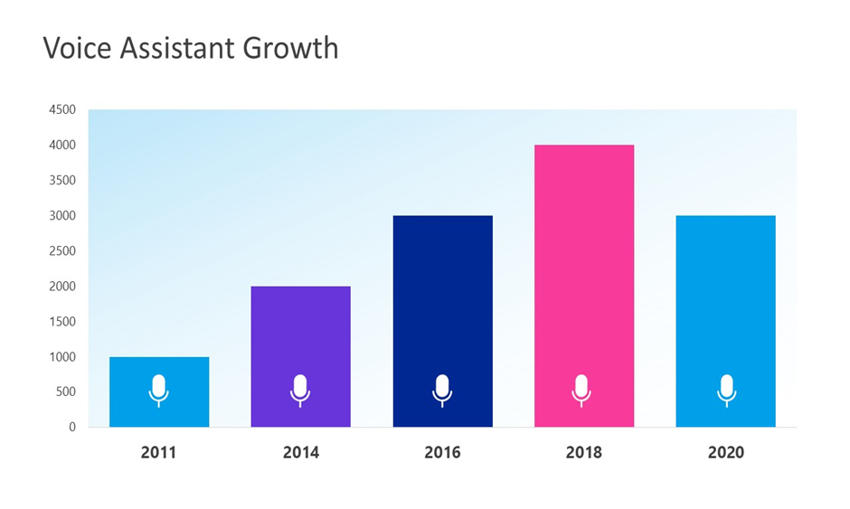
VOICE ASSISTANT GROWTH
PURPOS

Slide 13
CONCLUSION
The Virtual Desktop Assistant mini project seeks to provide a practical demonstration of how virtual assistants can augment daily computing experiences, improve productivity, and simplify complex tasks. The project's successful implementation will underscore the potential of virtual assistants in enhancing human-computer interaction and contributing to a more efficient digital workspace

Slide 14
THANK YOU
GUIDED BY:
PROJECT BY:
Dr. Guruprakash C D
PROFESSOR , Dept of CSE
XXX.
VARUN N K (20CSXXX)
VIGNESH (20CSXXX)

